Slide 1
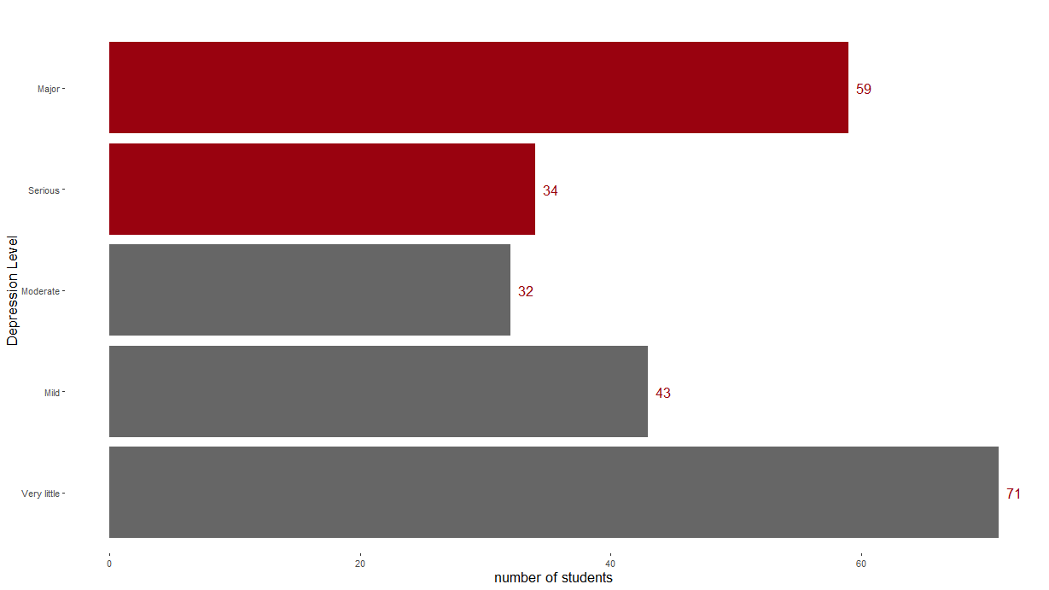
39% of the student suffers Major and Serious Depression

